Slide 1

Comparison of Stock Price Prediction Performance: ARIMA-ANN Hybrid vs. Transformer Neural Networks
Sridhar Chithathuru
50325478
Department of Computer Science and Information System

Slide 2
ABSTRACT
Artificial intelligence, including deep learning and machine learning, is influencing finance by predicting financial instrument movements.
The Yahoo Finance dataset shows the many firm aspects of the news, quotations, stocks, etc. in relation to time.
Utilizing transformers and ARIMA-ANN, helps analyze large data sets for accurate price predictions.

Slide 3
INTRODUCTION
Time series forecasting is a crucial area of forecasting, using previous observations to create models.
Markets are often vulnerable to unpredictability, with shares and values fluctuating dramatically.
A transformer model uses self-attention mechanisms.
ARIMA model is popular but unsuitable for nonlinear time series modeling.

Slide 4
APPROACH
Ten label stock tickers are shown using a prediction method based on TNN.
Nine tickers are used to illustrate feature extractions
Tenth ticker is predicted based on the nine ticker values.
Used a multi-objective function with a linear and non-linear structure to obtain the ticker's values.

Slide 5
TIME SERIES
A time series comprises of data points gathered over a period of time.
Monitors the evolution of a sample.
Changes in assets, security, and economic factors are examined using time series analysis.
Both fundamental and technical analysis make use of time series forecasting.

Slide 6
Deep Learning Models
Transformer Neural Network
Autoregressive integrated moving average –Artificial Neural Network (ARIMA-ANN)

Slide 7
TRANSFORMER NEURAL NETWORKS
The transformer is used to handle sequential data
An input phrase may be transformed from a sequence of vectors into an encoding vector using a transformer neural network.
Transformer neural networks assume the functions of earlier neural network designs

Slide 8
ARIMA-ANN
ARIMA is a statistical analysis model that uses time series data.
ANN are algorithms that simulate brain activity and are used to model complex patterns

Slide 9
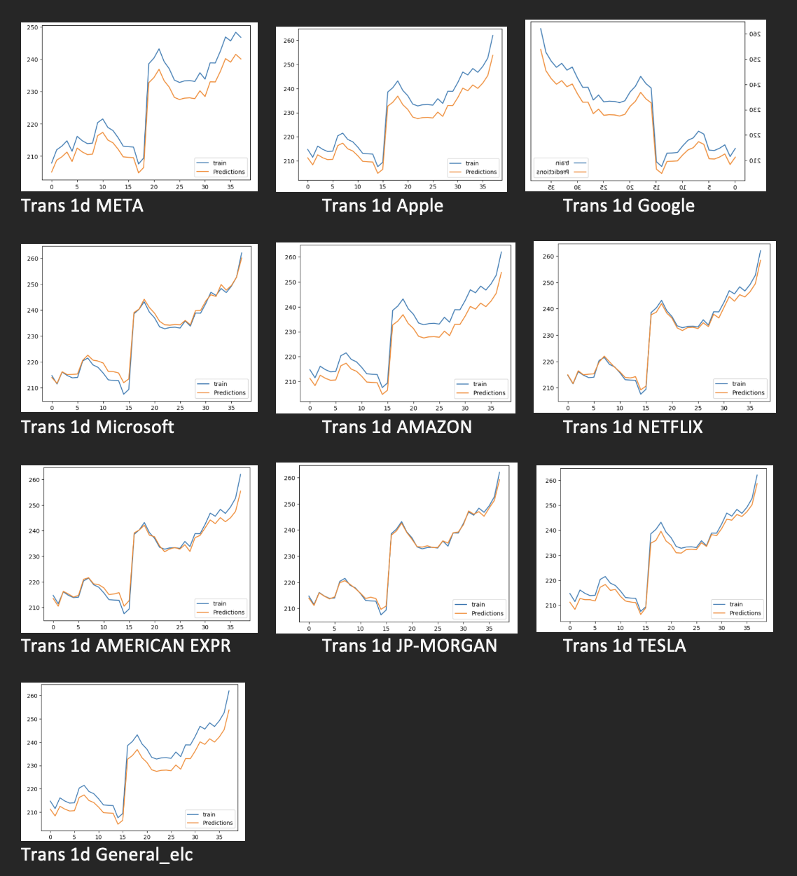
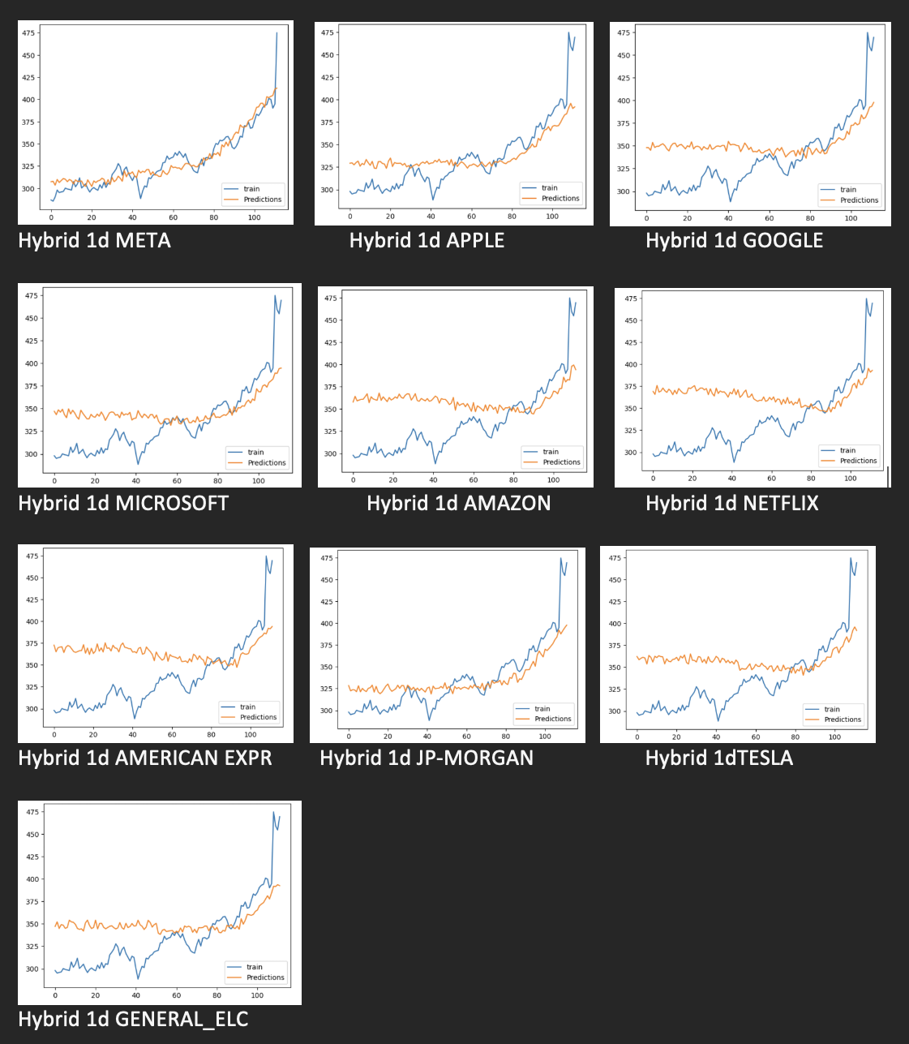
Results
Transformer Neural Network
ARIMA-ANN Hybrid

Slide 10
CONCLUSION
TNN model is significantly better than the ARIMA-ANN hybrid.
Overall design layer improvement with custom optimization layers may be applied to the design lowering the total loss

Slide 11


